Slide 1
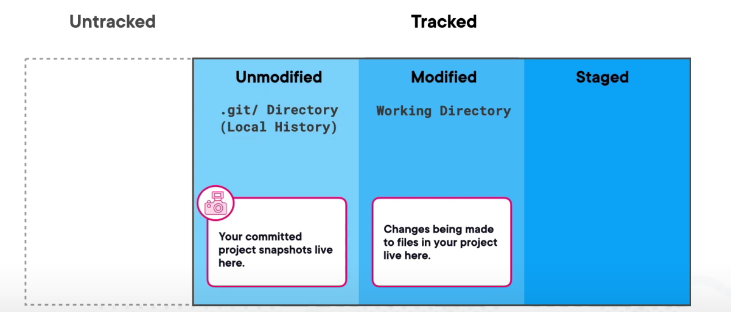

Different Directories of GIT

Slide 2
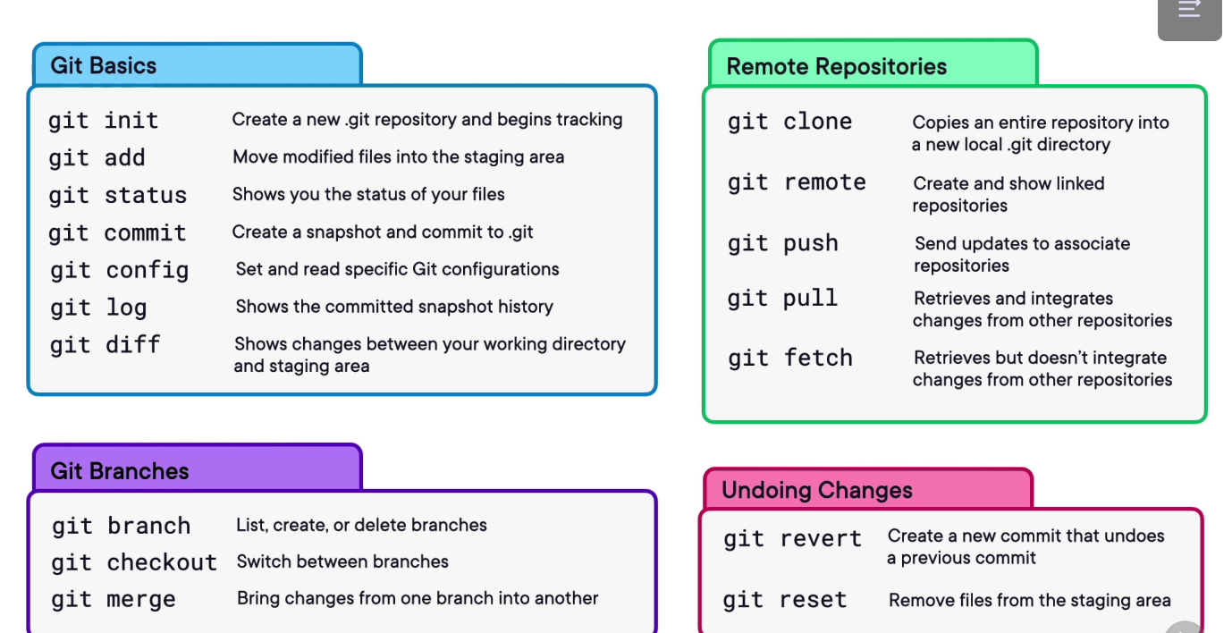
Common GIT commands

Slide 3
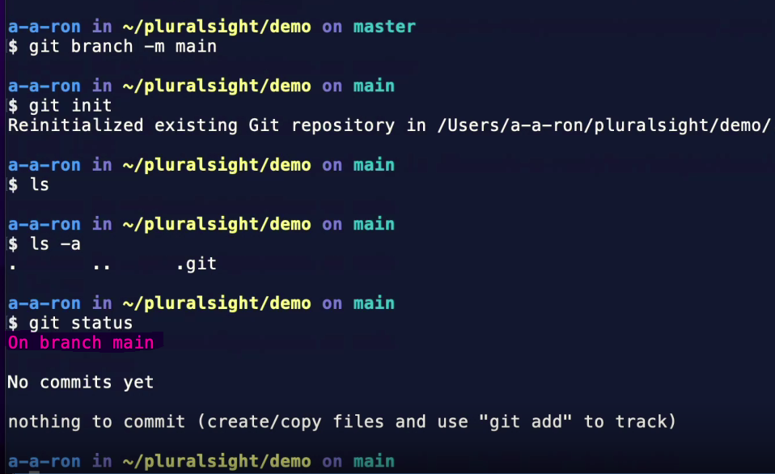
Creating New GIT repository

Slide 4
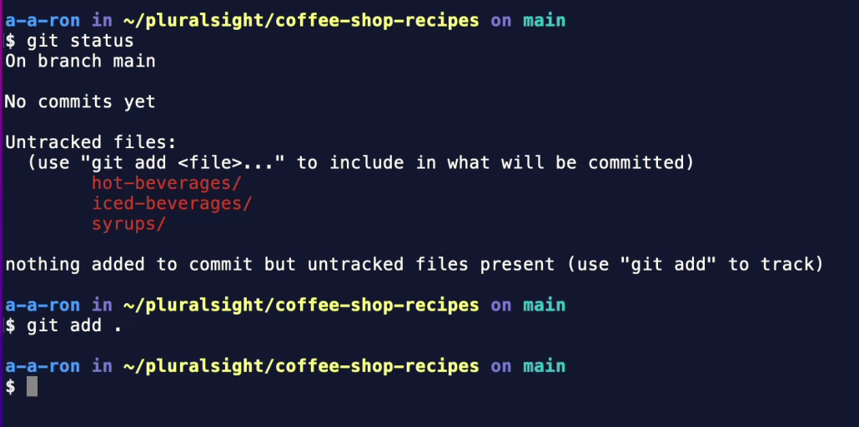
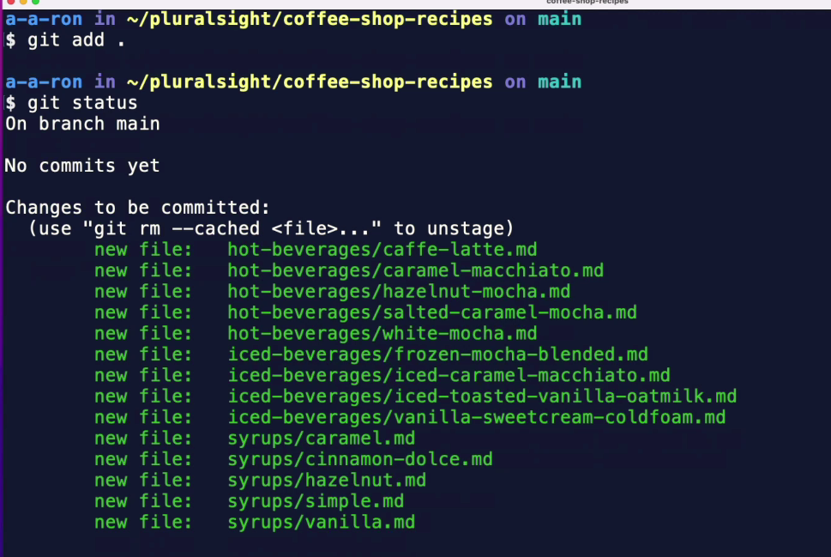
Adding and tracking new files
These are changes in staging Area waiting to commit to git repo for tracking

Slide 5
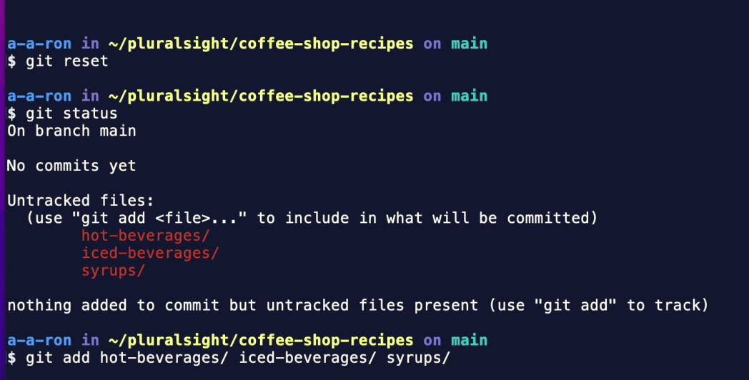
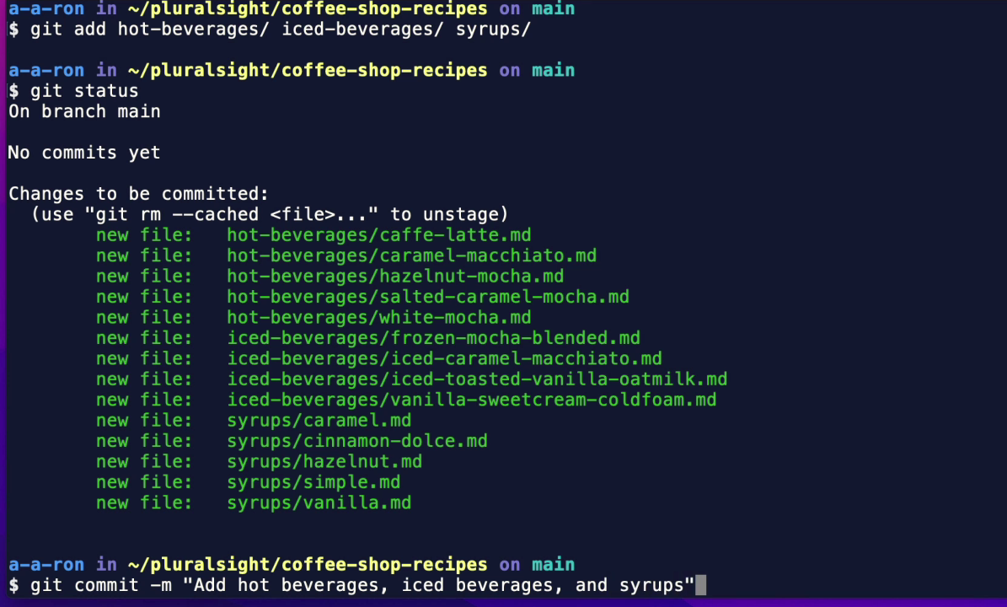
How to Untrack files when we don’t want to add all files

Slide 6
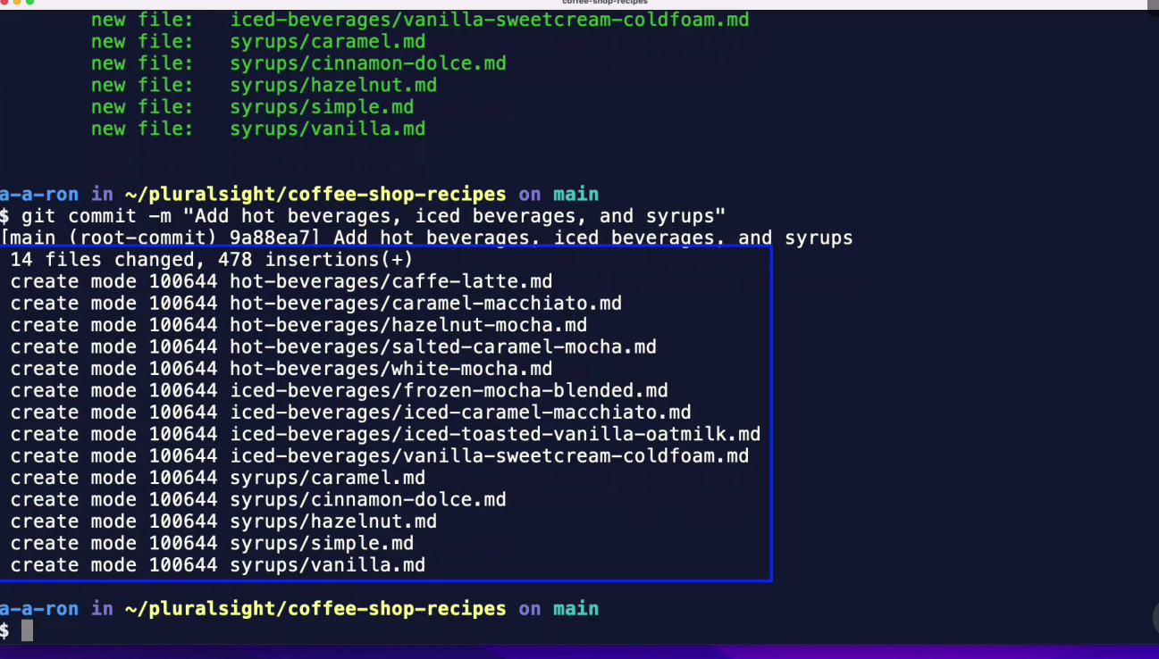
Continue….

Slide 7
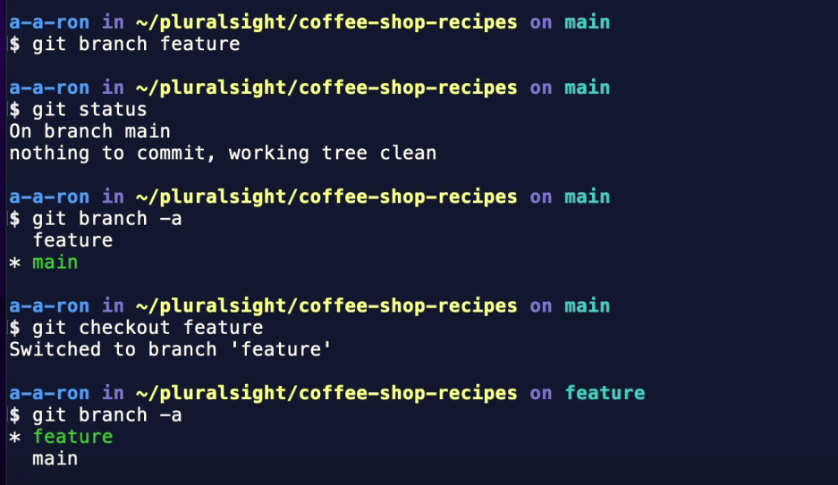
Creating a new Branch

Slide 8

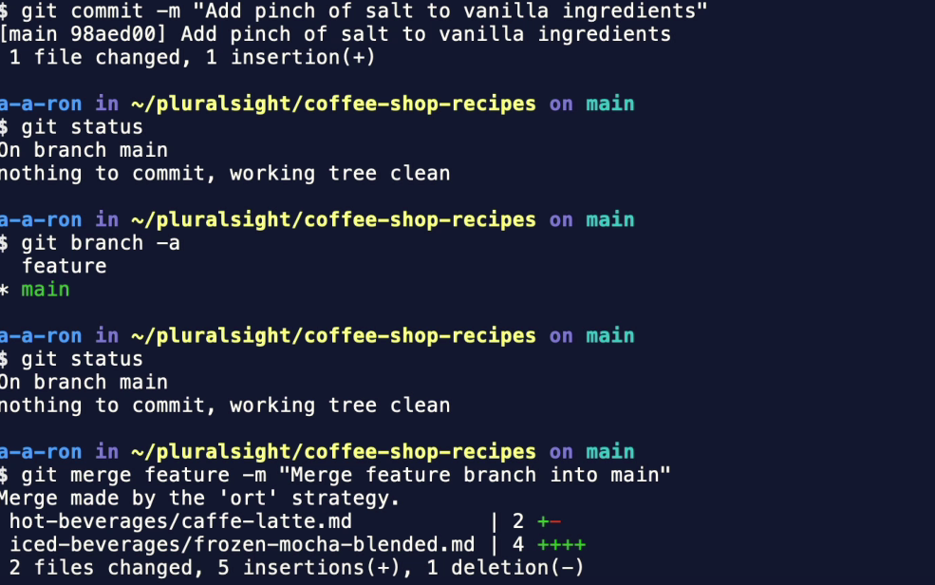
Merging a Branch into another Branch

Slide 9
